Slide 1
AlphaDate
https://github.com/joyOf/alpha-date
Cotiubinschii Leonid | 92126135

Slide 2
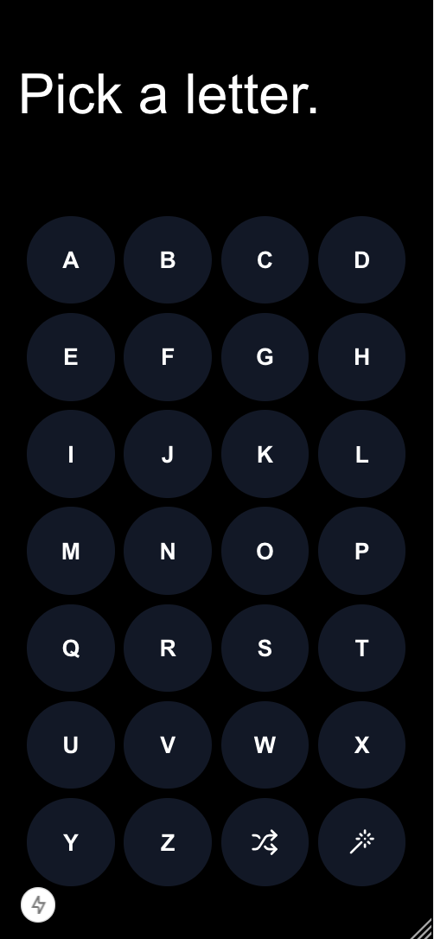
Find date ideas in a fast and easy way
Find date ideas using easy and familiar alphabet interface
Shuffle to get a new idea that starts with the letter you chose
Surprise yourself with a random idea

Slide 3
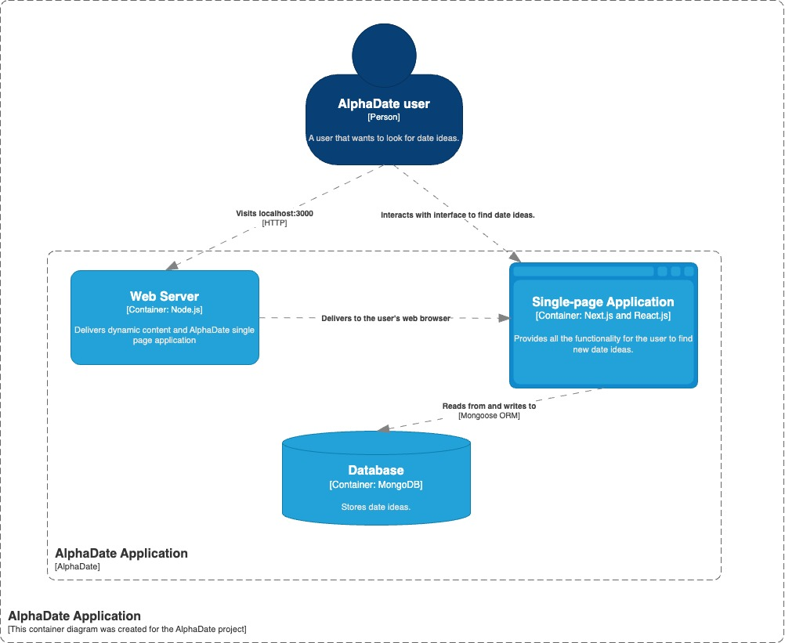
Diagram

Slide 4
Technology
This application is using a simple technology stack that consists of:
Next.js framework to handle the frontend with React.js as well as fetch data. Node.js is required on order to run Next.js
MongoDB to store data and Mongoose as an ORM

Slide 5
Functionalities
Get a date idea, shuffle and surprise

Slide 6
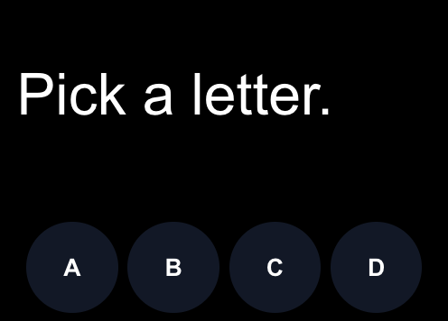
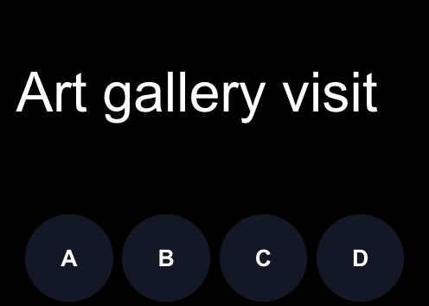
Get a date idea
Pick a letter to get a date idea that starts with that letter.

Slide 7
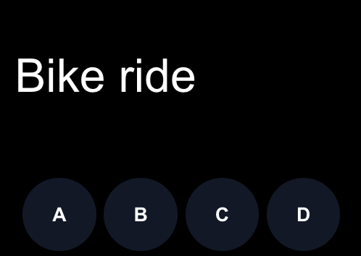
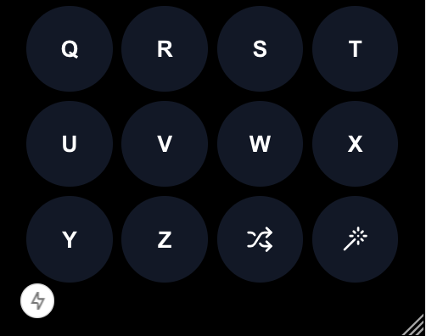
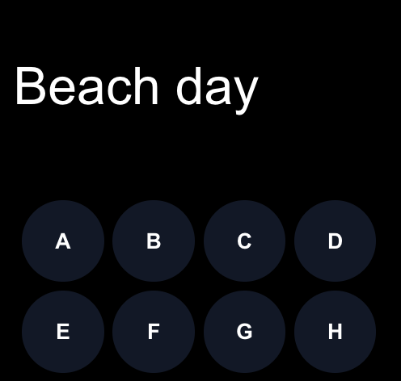
Shuffle
Click on the shuffle button to get a new idea that starts with chosen letter.

Slide 8

Surprise
Not sure what to choose and want to get a suggestion? Click on the surprise button to get a random idea.

Slide 9
Changes
Functionality
Instead of focusing on management of the ideas I decided to help find ideas, thus changed the functionality to focus on the alphabet picker and related functionalities.
Technology
Next.js: Initially I thought I would write the application in pure HTML, CSS and JavaScript. Once I realized that I would need to create a lot of components from scratch as well as adding API/database calls, the codebase started to grow rapidly and wasn’t very clean. To be more efficient, I opted for a library like Next.js that allows for building components with React.js as well as has tools to execute API calls.
For simplicity reasons I have decided to not write a web server in Go and move all the API calls in the full-stack app in Next.js
MongoDB: My choice of the database has changed from SQLite to MongoDB because I don’t have multiple entities with complex relations. Additionally, MongoDB is quite simple to setup and use locally.

Slide 10
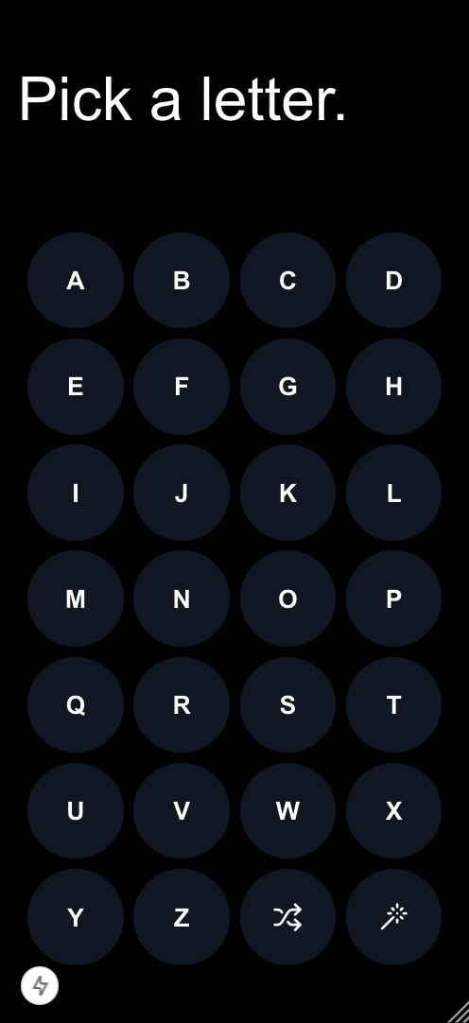
Demo

